Slide 1

Blockchain Master – L0/L1 Overview
Raimund Gross
March 2017

Slide 2
Disclaimer
The information in this presentation is confidential and proprietary to SAP and may not be disclosed without the permission of SAP. Except for your obligation to protect confidential information, this presentation is not subject to your license agreement or any other service or subscription agreement with SAP. SAP has no obligation to pursue any course of business outlined in this presentation or any related document, or to develop or release any functionality mentioned therein.
This presentation, or any related document and SAP's strategy and possible future developments, products and or platforms directions and functionality are all subject to change and may be changed by SAP at any time for any reason without notice. The information in this presentation is not a commitment, promise or legal obligation to deliver any material, code or functionality. This presentation is provided without a warranty of any kind, either express or implied, including but not limited to, the implied warranties of merchantability, fitness for a particular purpose, or non-infringement. This presentation is for informational purposes and may not be incorporated into a contract. SAP assumes no responsibility for errors or omissions in this presentation, except if such damages were caused by SAP’s intentional or gross negligence.
All forward-looking statements are subject to various risks and uncertainties that could cause actual results to differ materially from expectations. Readers are cautioned not to place undue reliance on these forward-looking statements, which speak only as of their dates, and they should not be relied upon in making purchasing decisions.

Slide 3
The value-add of Blockchain
$3.1 trillion
$176 billion
2025
2030
Gartner Report „Forecast: Blockchain Business Value, Worldwide, 2017 – 2030” (ID: G00325744)
Notes:
In the study “Deep Shift: Technology Tipping Points and Societal Impact” from September 2015 by the World Economic Forum blockchain is listed as one of the driving forces of the megatrend “The sharing economy and distributed trust”.
In a forecast on the blockchain business value 2017 – 2030 Gartner estimates the value-add of blockchain to grow to more than $176 billion by 2025, and then it will exceed $3.1 trillion by 2030. The worldwide blockchain market could reach $5.43 billion (€5 billion) by 2023, up from $228 million (€210 million) in 2016, per a study by Allied Market Research. Most of that is private blockchain, and AMR doesn’t expect that to change anytime soon.
http://www.weforum.org/reports/deep-shift-technology-tipping-points-and-societal-impact
Gartner Report „Forecast: Blockchain Business Value, Worldwide, 2017 – 2030” (ID: G00325744)
https://www.alliedmarketresearch.com/blockchain-distributed-ledger-market

Slide 4
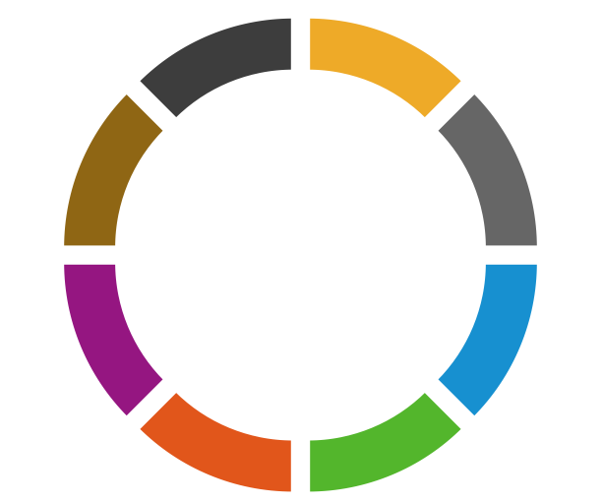
Blockchain in numbers
Over $1,4bln investments over the past 3 years⁴
71%
of business leaders using Blockchain believe it plays a key role in advancing the technology and reestablishing industry standards²
83%
of life science leaders believe Blockchain will be adopted within 5 years¹
90+
central banks engaged in DLT discussions worldwide⁴
>50%
of companies in consumer products, life science, healthcare, tech and media already deploying Blockchain solutions⁴
Market cap of public Blockchain assets breaks $100bln³
2500+
patents filed over last 3 years⁴
24+
countries currently investing in Blockchain⁴
Finds Survey from The Pistoia Alliance , 20.09.2017
Blockchain Technology: use cases, statistics, benefits , 20.09.2017
Coindesk. State of Blockchain Q2 2017 , 20.09.2017
Deloitte. The future is here , 20.09.2017

Slide 5
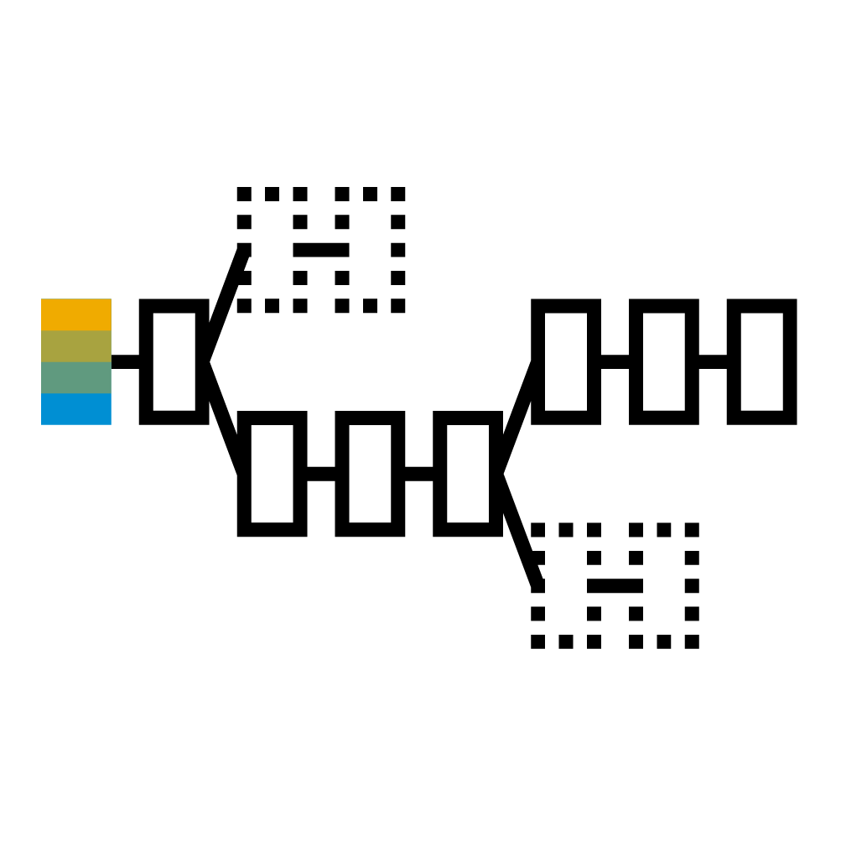
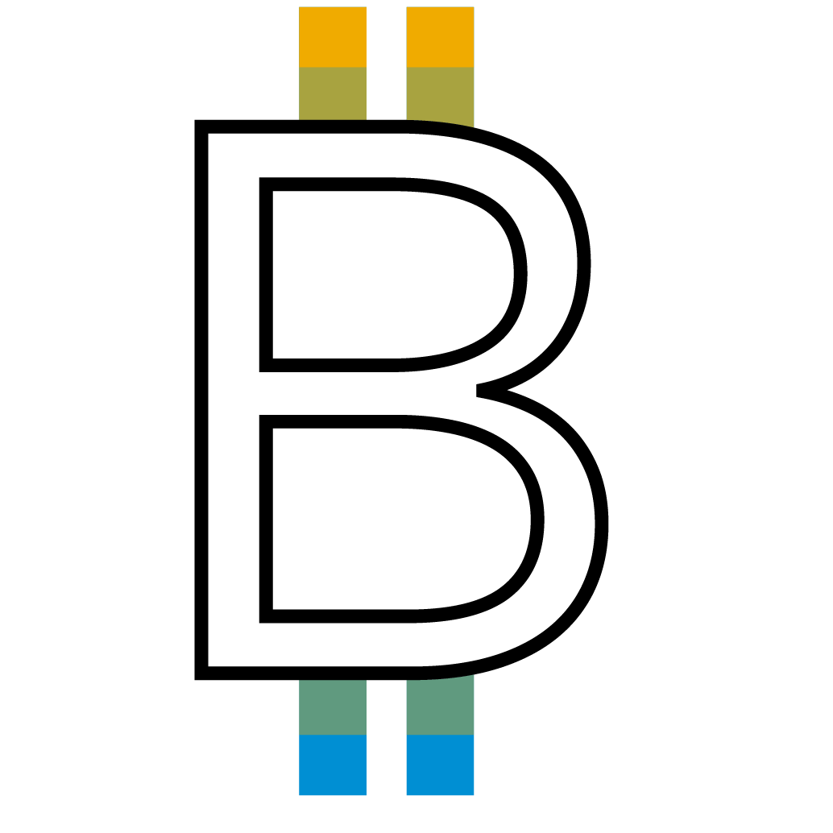
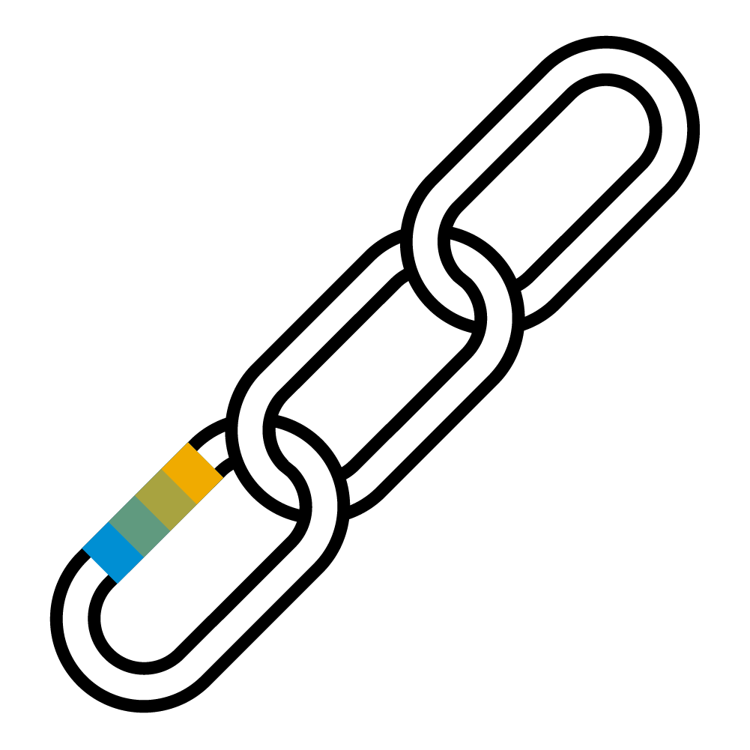
What is Blockchain?
Distributed Ledger Technology
Bitcoin
Blockchain
Cryptocurrency encryption techniques are used to verify the transfer of funds; operating independently of a (central) bank.
Architectural concept that enables the decentralized, secure, direct, digital transfer of values and assets.
Distributed ledger consensus of replicated, shared digital data spread across multiple sites, countries, or institutions. No central administrator or centralized data storage.
Notes:
Often Blockchain is used or understood synonymous with Bitcoin. It is not.
Blockchain is an application on top of a much broader fundament. A horizontal architecture and concept called blockchain.
While Bitcoin does perform exceptionally well for the case it was build it falls short on other areas.
There are more than 70 different blockchain technologies and frameworks in the market currently (Gartner count as of 03/2017). So the technology is developed further and deficits are addressed.

Slide 6
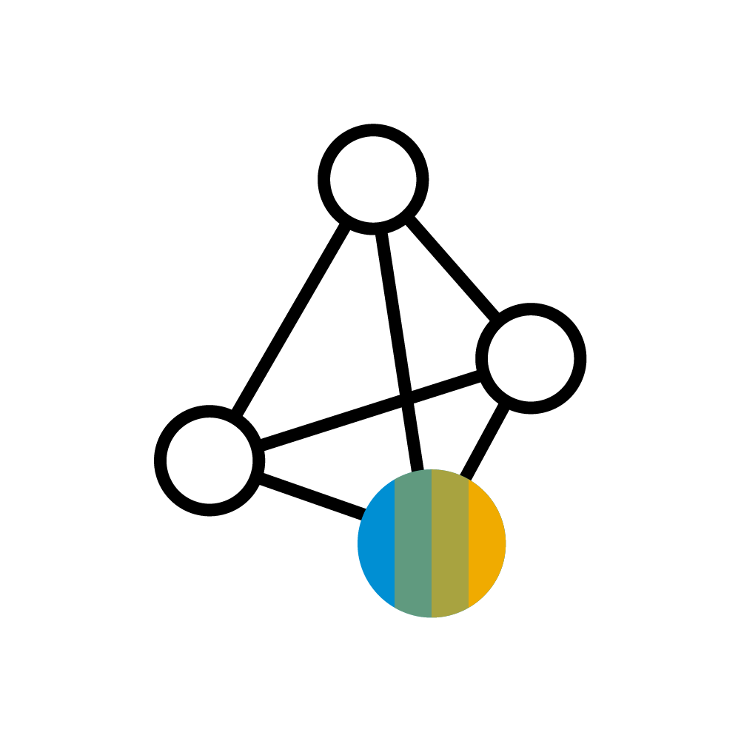


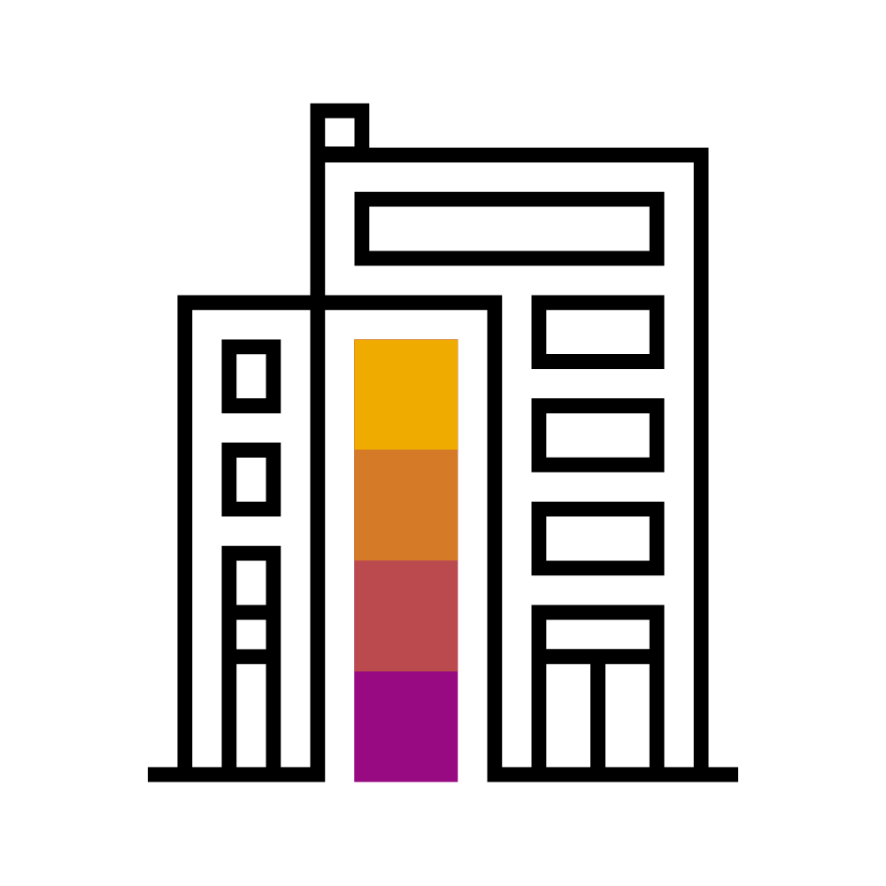

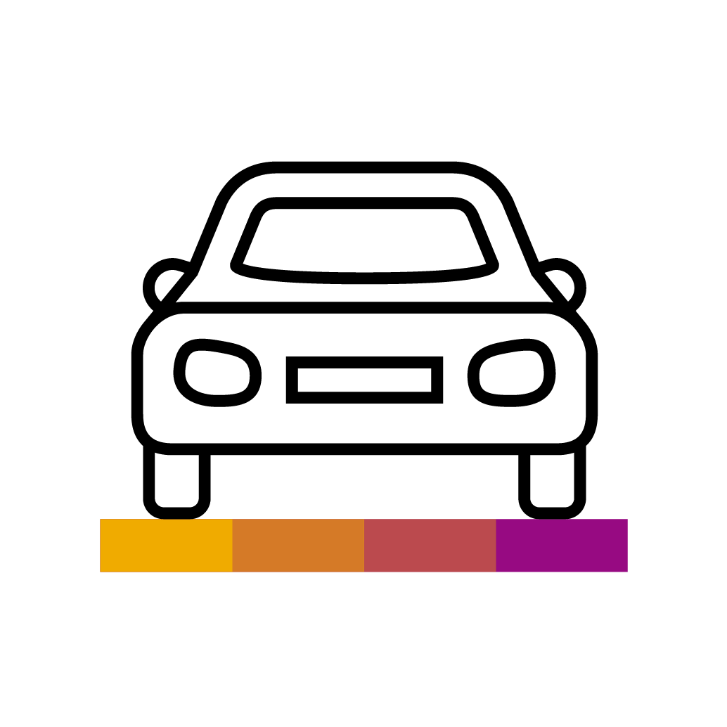
Blockchain can transform transactional networks
Compliance and Legal Documentation
Quality Assurance
Government
Blockchain is a new protocol for distributed ledgers in multi-party business processes.
Supplier
Company
Payments
Decentralized Voting
Trade Finance
Bank
Individual
Connected Car
Notes:
Business Benefits:
Trust between participants without central authority (secured by cryptography and consensus algorithm)
Operational simplification of collaborative scenarios (decentralized control, direct peer-to-peer interaction)
Increased transparency, auditability and regulatory compliance (immutability of records)
Real-time value transfers (digital assets)
System-enforced inter-company business rules (smart contracts)
Risk reduction without intermediaries

Slide 7
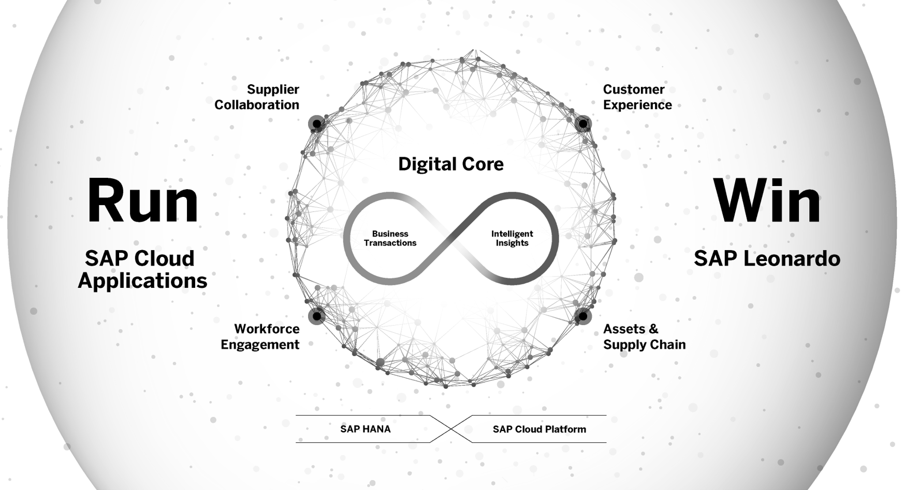
SAP Leonardo: Fully integrated with SAP applications
Notes:
Customers need a way to transition today’s reality to the future. They face changes in the market but are bound to their current realities – expressed in existing IT landscapes, the need to operate them and the weight and scale of those investments.
While companies need to optimize their existing processes the need at the same time look at ways to reinvent their business models. At the same time, new concepts and technologies arise – blockchain only being one of them.
Being confronted with multiple conceptual and technical inventions customers are looking to SAP for help, support, understanding and direction with those topics. Specifically, and even more for topics that are beleaguered by hype and misconception resulting in confusion – such as blockchain currently.

Slide 8
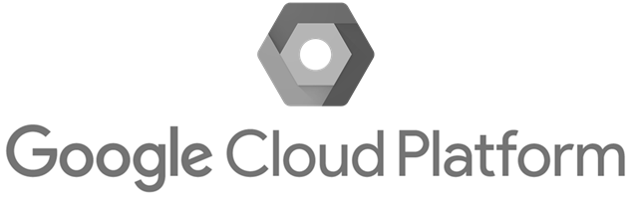

SAP Leonardo Digital Innovation System
Data Intelligence
Analytics
Design Thinking Services
Blockchain
Internet of Things
Machine Learning
Big Data
SAP Leonardo Technologies
SAP Cloud Platform
Microservices Open APIs Flexible Runtimes Integration
Multi-Cloud Infrastructure
SAP Data Center
Microsoft Azure
Notes:
We embed blockchain technology into SAP Leonardo offerings and combine them with other next-generation technologies, such as our Internet of Things or machine learning capabilities
Our ambition is twofold: we want to benefit our customers with efficient operations, while at the same time transferring knowledge by turning concrete customer scenarios into actions.
Blockchain is one of the new technologies that help realize digital transformation and innovation. As part of the SAP Leonardo offering it provides capabilities that help to realize business transactions in a peer-to-peer network and distributed fashion.

Slide 9
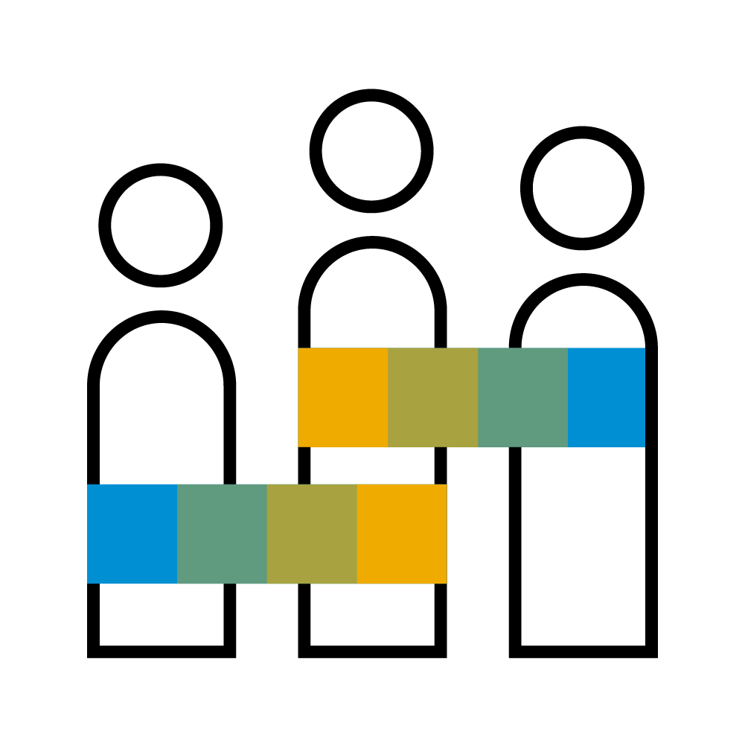
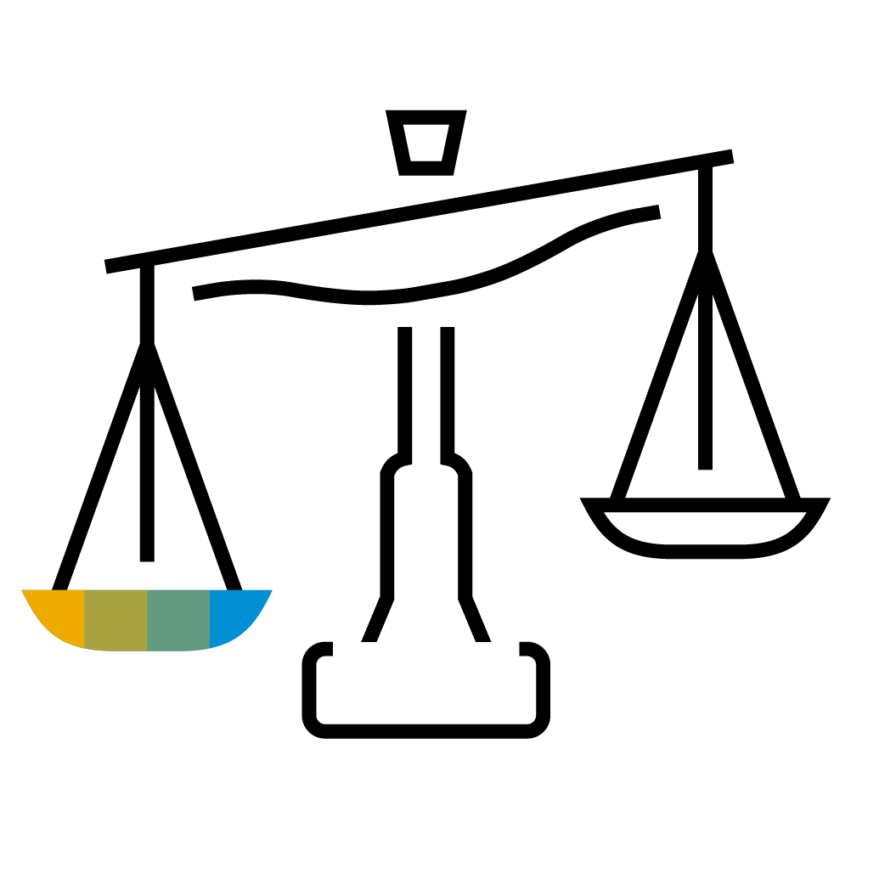


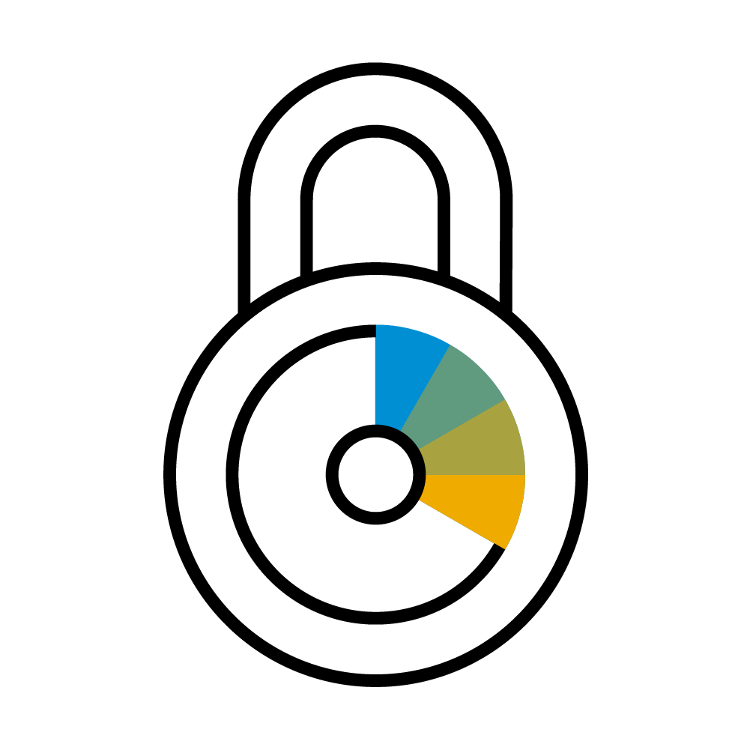
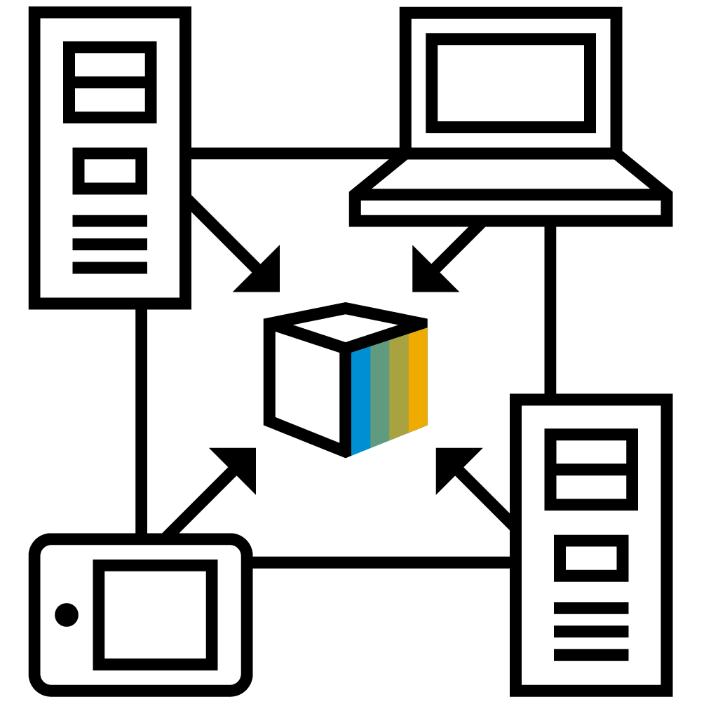
Value Drivers of Blockchain
Multi-Party Collaboration
Information Imbalance
Process Optimization
Transparency & Auditability
Security
Digital Assets
Notes:
If a case/idea/scenario does not include multiple participants from different organizations (multi-party collaboration) there is a high chance that it is not blockchain relevant.
Once you identified multi-party collaboration you need to look at the other drivers to find the “value add” of using blockchain as a technology in realizing the process.
Reduction of 3rd party requirements and increased processing speed (verification, trust, auditing)
Multiple parties need to access the same set of information (but are not part of the same organization/entity)
Transaction consistency for interaction between untrusted participants
The sequence or specific time of events is important (proof that something did happen at a specific point in time)
Records may not be changed, re-ordered or removed (documentation liability) / tamperproof history regarding date, time and sequence / secure data and processes more efficiently)
The main focus is on digital assets as the interface to analog objects is more tricky and not part of the build-in capabilities (digital currencies, financial instruments, rights, IP, ownership just to name a few)
Information transparency – no censorship, availability of public information (tracking and tracing of information)

Slide 10


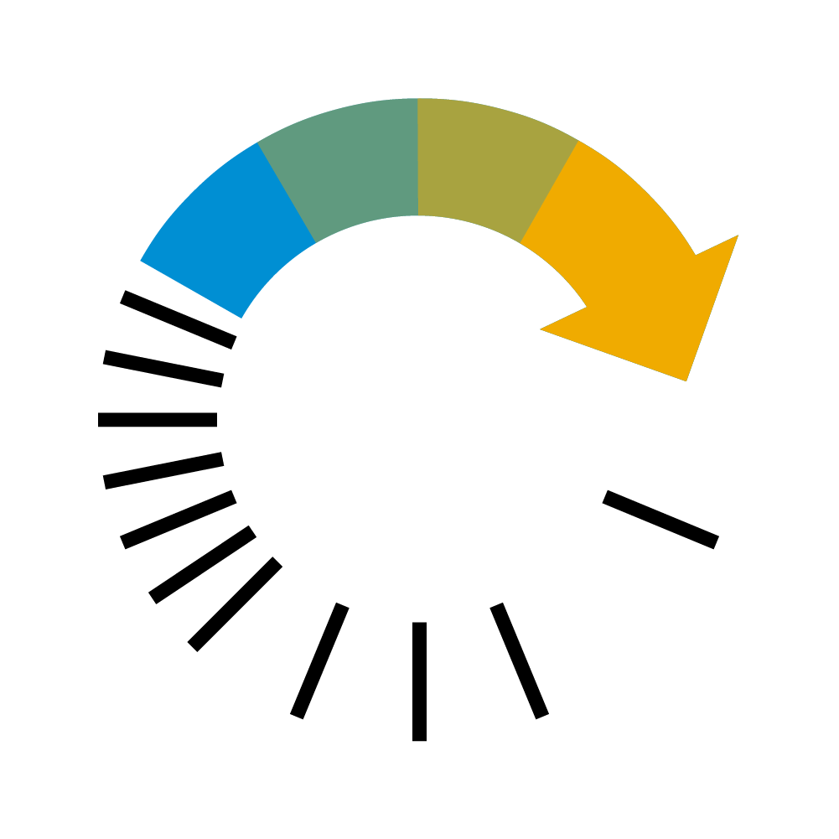

SAP Leonardo Blockchain – The Trust Engine
Foundation for building transactional applications that establish trust and transparency while streamlining business processes across company boundaries.
Fewer Intermediaries
Efficiency
Transparency
www.sap.com/blockchain
Faster Processes
Security
Automation

Slide 11
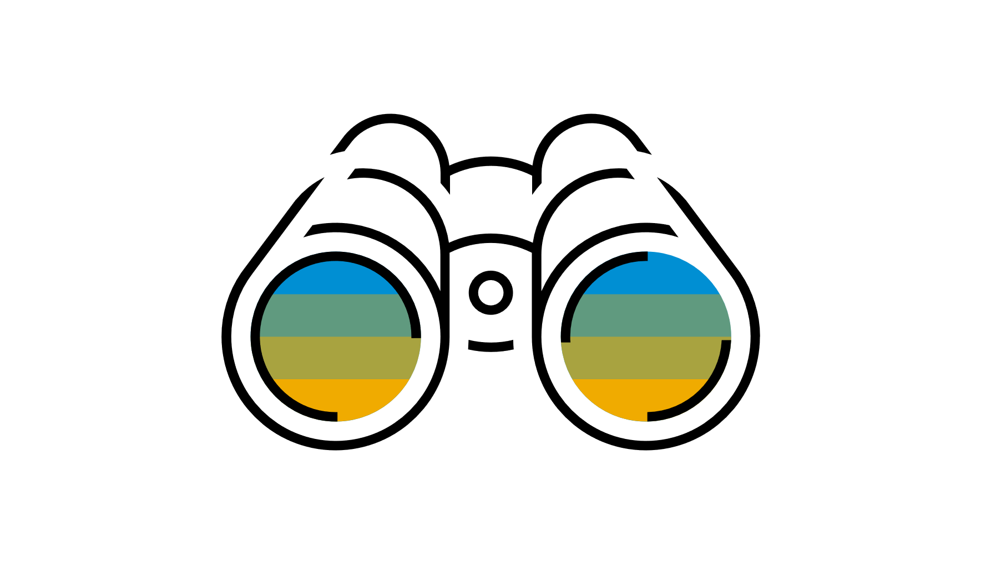

Blockchain Value Drivers for Business
Process Optimization
Time & Cost Reduction
Transparency & Auditability
Risk & Fraud Minimization
Multi-party collaboration on single version of truth
Peer-to-peer network without intermediaries
Undeniable history due to immutability of records
Provability & automated business rules (smart contracts)

Slide 12
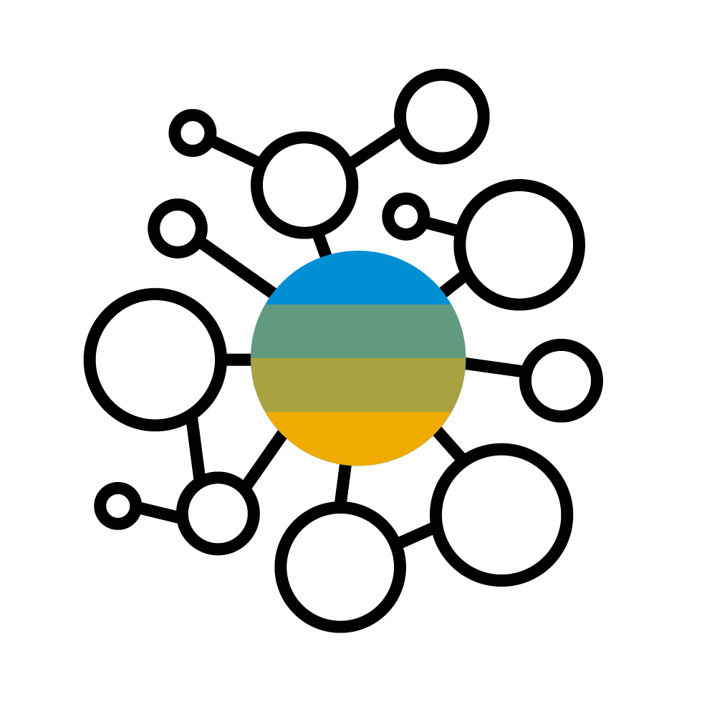
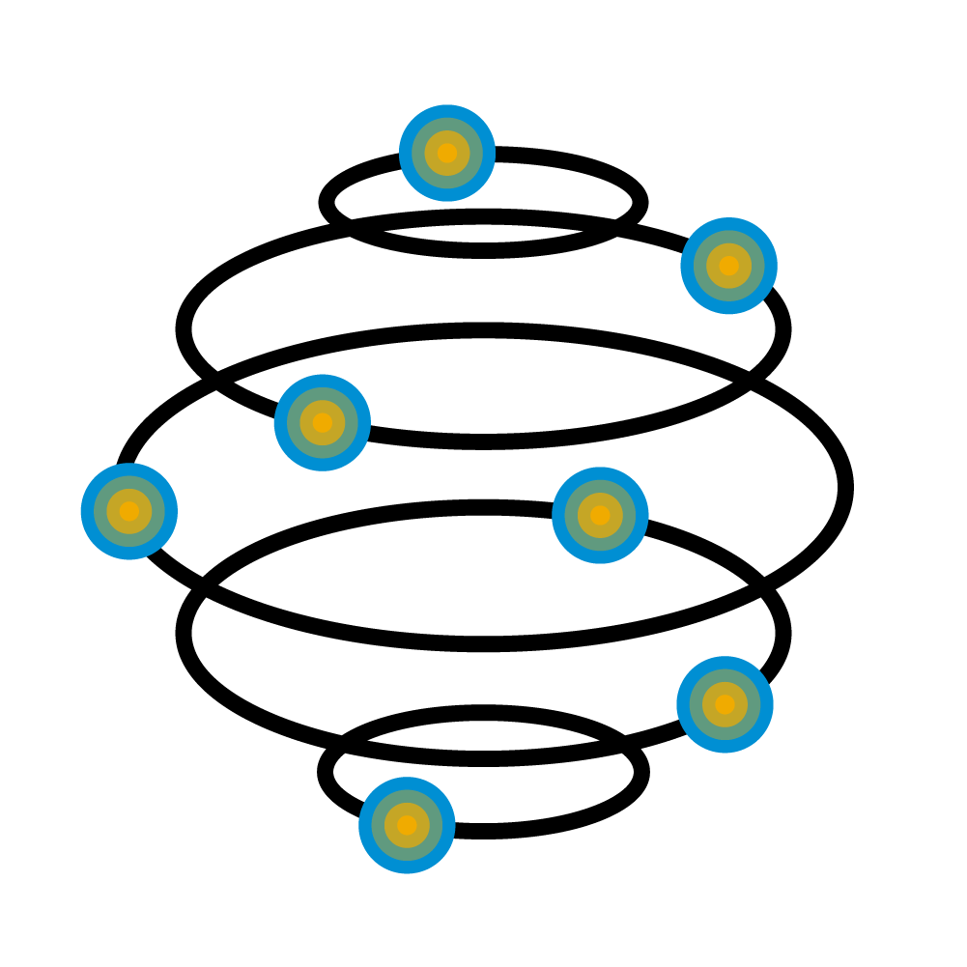
Blockchain deployment options
Public
Consortium
Permissionless Blockchain
Permissioned Blockchain
Open for everyone to participate and read/write.
Access and permissions controlled by pre-selected set of nodes
Notes:
Like in the cloud environment where we have public and private clouds we see the same occurrence in the blockchain eco-system. Enterprises are typically not enthusiastic to conduct their business in full openness and the public. Consortia using permissioned blockchains address that concern.
Public: open, pseudonymous, algorithmic effort high
Permissioned: restricted access, known IDs, less effort
More but not full trust -> less but not no effort
Some facts about consortia (2016):
25 global consortiums
Largest memberships: 100 (Hyperledger and ISITC)
Total number of participants: 550
https://www.google.com/maps/d/u/0/viewer?mid=1L56UMOPbUUGAzCSPyq8ZGNvzuRM&hl=en_US&ll=20.22949032822979%2C-100.97839149999993&z=2

Slide 13


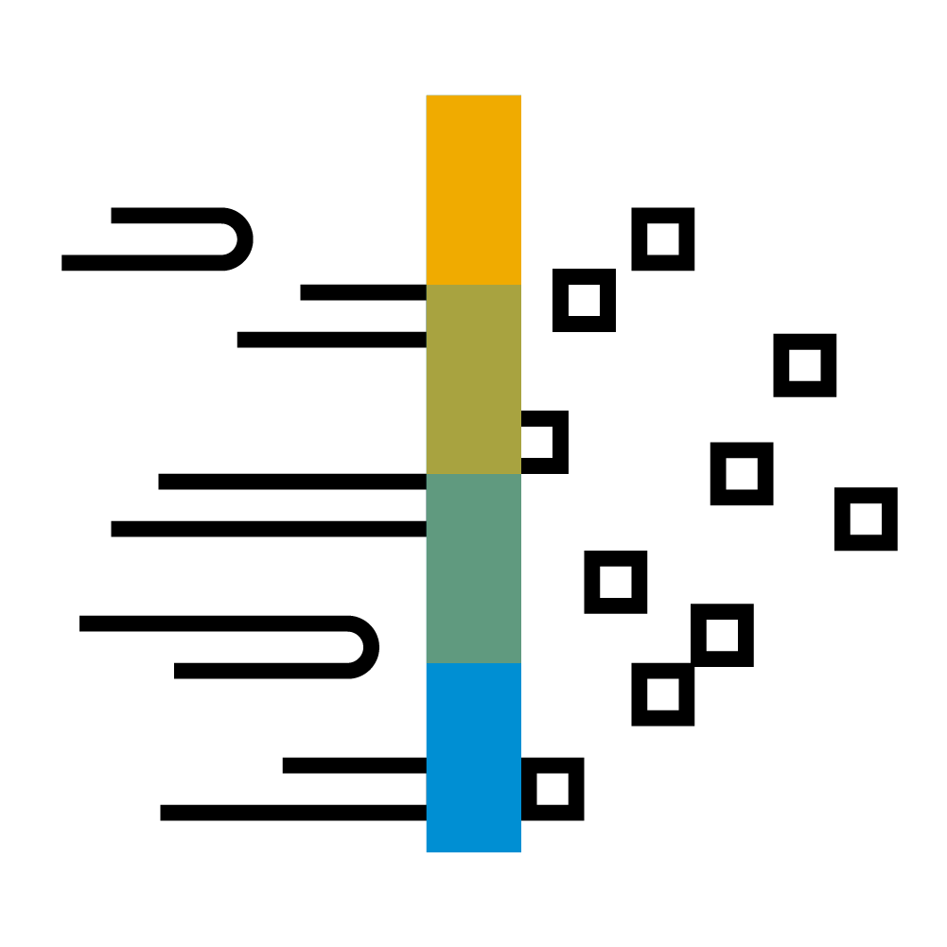
Blockchain time horizons
Optimize
Reimagine
Revolutionize
Enhance the core with emerging technology
Disrupt and create new business processes
Disrupt and create entire businesses and markets
Notes:
Different time horizons that blockchain innovation can be relevant. Increased difficulty to achieve results
Today: optimize (here and there already)
2-5 years: Reimagine (processes we have today will be done differently tomorrow)
5+ years: Revolutionize (this is where the significant market shifts and changes are expected)
-------------------
In “optimize scenarios” procedures on existing SAP solutions can benefit from blockchain capabilities by incrementally extending a current process with additional features. An example would be an additional proof of authenticity based on blockchain as part of a raw material sourcing process. Optimize scenarios can be addressed with technology and functionality that is already available in the blockchain eco-system and SAP Cloud Platform today.
In “reimagine scenarios” existing business processes are significantly impacted or entirely new ones are created that have not been possible before. An example would be bidding and request for quotation processes that can be executed more trustful and with higher security based on distributed ledger technology. Reimagine scenarios are more complex to realize than pure optimization cases due to technology only emerging and lack of experience in productive scenarios. Therefore, they are on a timeline between 2-5 years from now.
In the future “revolutionize scenarios” will disrupt complete business and create entirely new markets. As this is on a 5+ year timeline from now it is not seriously predictable which areas will emerge first. Assuming the paradigm shift of business in more de-central networks progresses it is easy to see current sharing-economy incumbents go out of business.

Slide 14

Blockchain in Enterprise Processes
S/4HANA Enterprise Processes
Enterprise Processes
Enterprise Processes
Process Layer
Cross Company/ Industry Business Processes
Cross Company
Cross Company/ Industry Business Processes
Cross Company/ Industry Business Processes
Abstraction / API
Enabling Layer
Blockchain-as-a-Service
Immutable Data Exchange
Blockchain Node(s)
Blockchain Node(s)
Blockchain Node(s)
Cloud Platform
Cloud Platform
On Premise
Notes:
Innovation does not happen in isolation. There is always an existing customer situation, established business processes and a classic system infrastructure that need to be considered. SAP Cloud Platform is our innovation and extension platform that also now is offering blockchain capabilities.
One the enabling layer there is the technical integration that is necessary to have different connectivity between different participants. This is where blockchain will play a major role in collaborative, peer-to-peer scenarios.
The key part is to understand, that with blockchain we cannot expect a homogenous infrastructure and technology stack. The whole concept needs to be open to support blockchain technology running on different platforms. And nevertheless being able to interact with each other.
And then there is the business process layer also allowing for a semantical integration of cross-company activities and process flows. This is the level where we want to bring together classic/existing SAP solutions with the new capabilities of the emerging blockchain eco-system.

Slide 15
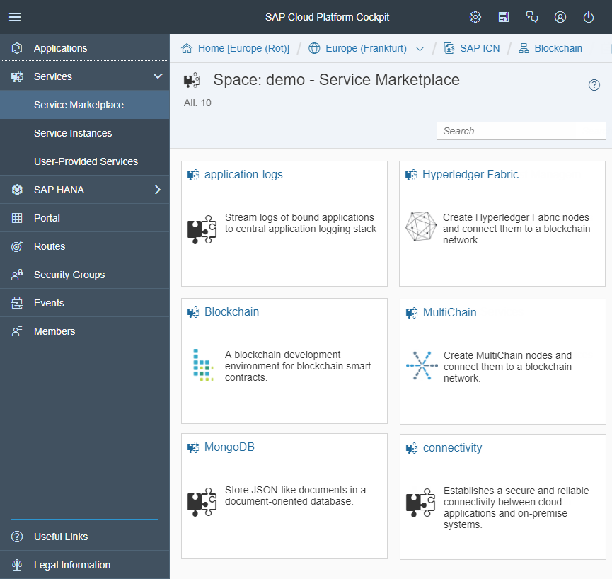
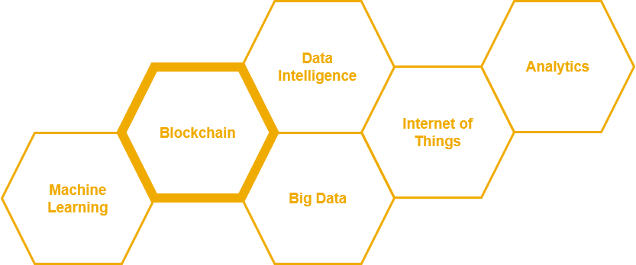
SAP Cloud Platform Blockchain Service
Early adoption opportunities for customers to support the realization of innovations (version 1.0 solutions)
Build blockchain extensions for existing applications across industries and lines of business
Different technologies to allow an integration of business processes to various blockchain-based networks and infrastructures
Establish iterative feedback cycles between customers and development team
Continuous co-innovation to validate ideas with customers, partners and startups

Slide 16


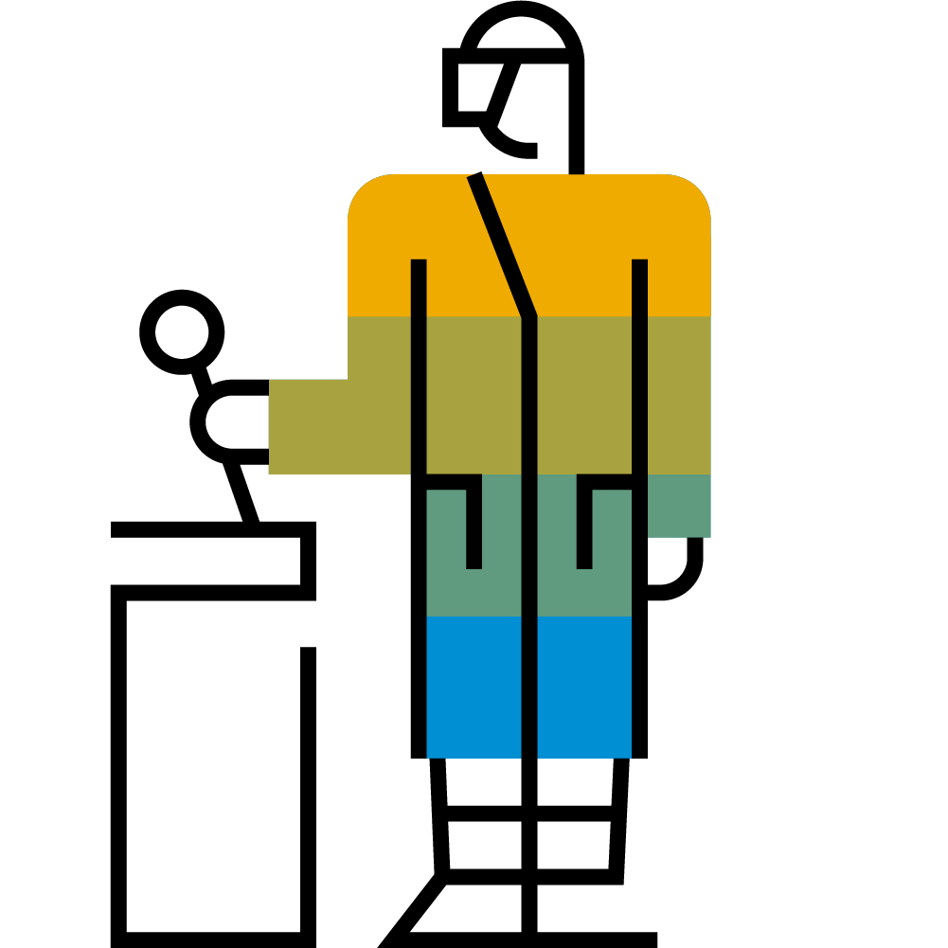
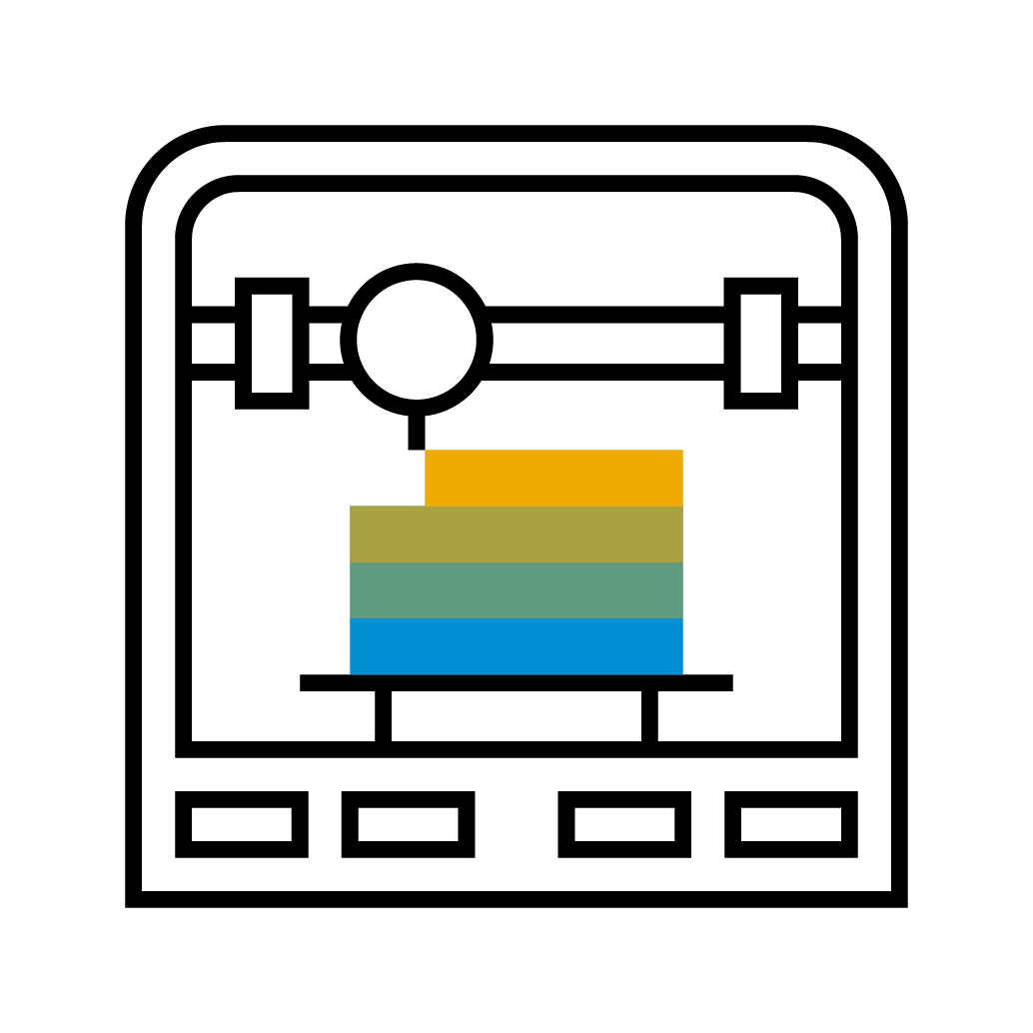





Conducted Blockchain Use Cases Across different LoBs and Industries
Secured Authorization Procedures in Public Sector
Ocean Liner Shipping (e-Bill of Lading)
Asset Management (Digital Twin)
Distributed Manufacturing (3D-printing)
Trusted Digital Credentials
Secure Bidding in Procurement
Guarantee Network
Real-Time Payments
Drug Supply Chain Security
Disaster Operations
Notes:
List of scenarios covered by SAP (internal link)
https://jam4.sapjam.com/blogs/show/qv9SrN51FFXAbnbEYCEHam?_lightbox=true

Slide 17
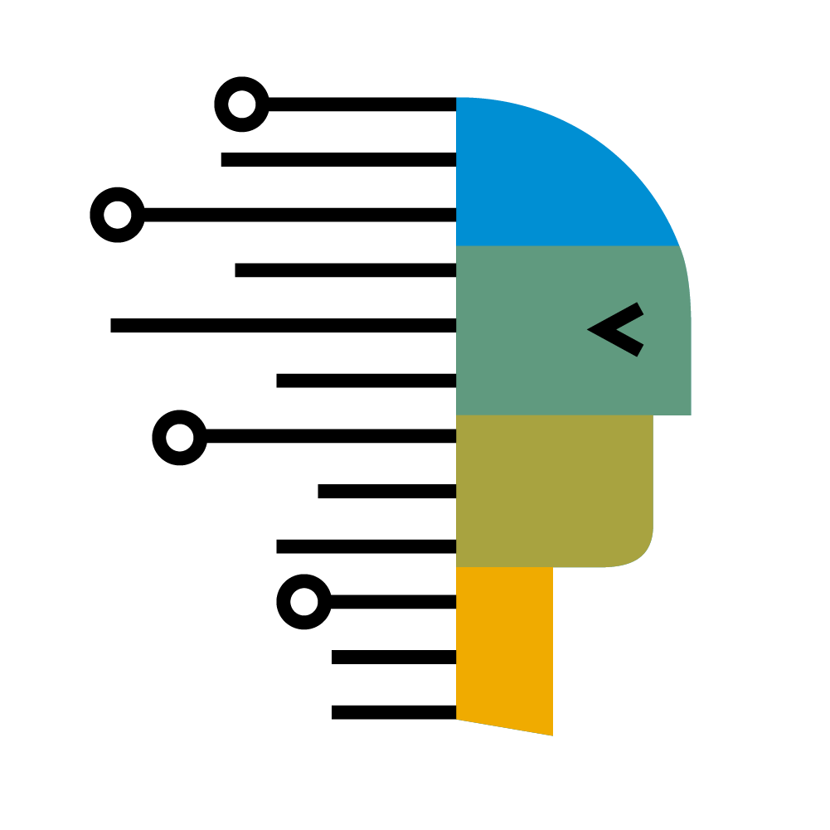
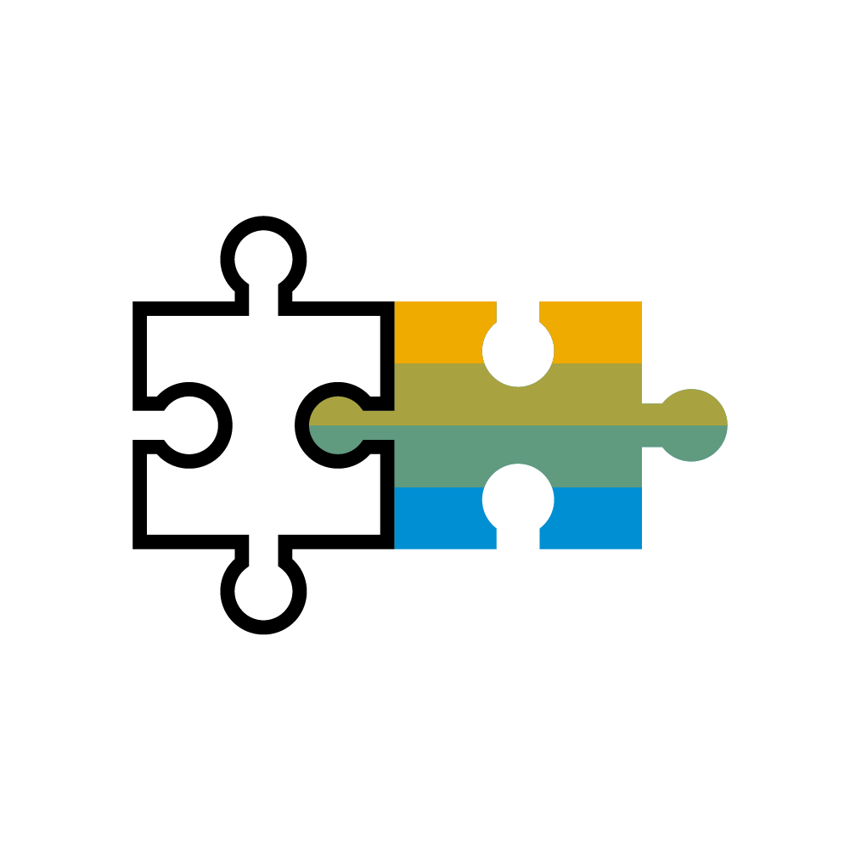

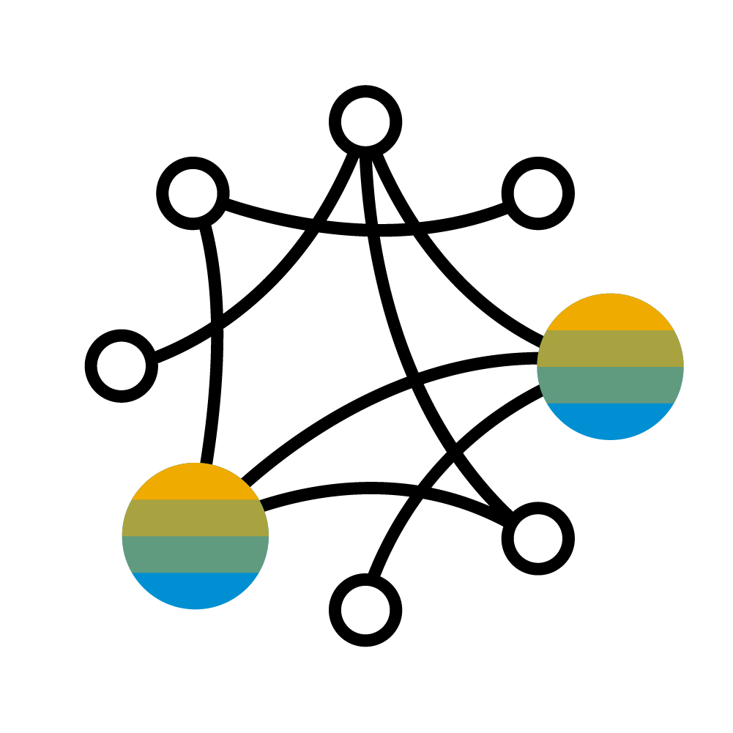

Future Direction: SAP Leonardo Blockchain Enabling customers and partners to leverage Blockchain capabilities
SAP Leonardo Blockchain
Business Services Ready to use business patterns
Application Integration Services Ready to infuse into SAP solutions
Foundational Services
Ready to build business applications across blockchain technologies
Ecosystem Ready to re-imagine
SAP Cloud Platform
Notes:
Story flow:
Innovation does not happen in isolation. There is always an existing customer situation, established business processes and a classic system infrastructure that need to be considered. SAP Cloud Platform is our innovation and extension platform that also now is offering blockchain capabilities.
Foundational Services allow the technical connection of different blockchain technologies into SAP Cloud Platform and therefore business processes.
Application Integration Services cater for the integration of existing (on premise) SAP solutions so that blockchain capabilities can be uses.
Business Services are ‘higher level’ services that combine commonly used business patterns into easy to use scenarios. [Business patterns: like blue prints for commonly used scenarios such as provenance, assets transfer or analytics]
This all can be done from within the SAP innovation and extension platform (SAP CP) but in an open and collaborative way that allows connection and integration to the (outside) blockchain eco system.

Slide 18
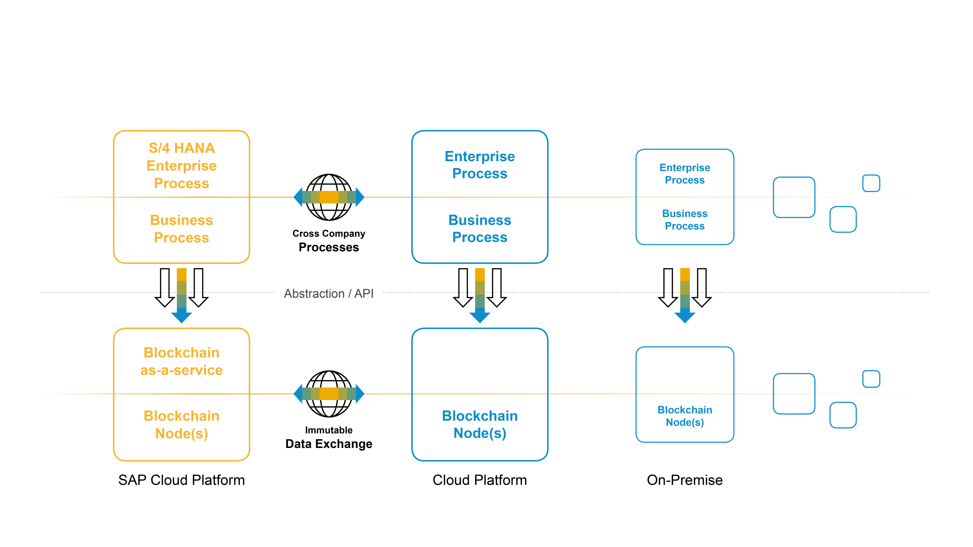
Our Vision For Blockchain-enabled Enterprise Processes
Notes:
SAP focus on value-add, business relevance and processes -> adjust the playing field to make blockchain more a discussion in an industry/LoB context and not in the technical domain. This is where SAP’s experience and value for the customers resides
The core idea of blockchain is different peers participating in a common network. While collaborating in a network it is reasonable to assume that participants in the eco-system will not always use that same platform and technology stack. Thus, blockchain technology will serve as the standardization and integration component to connect partners that operate on different platform stacks. A common and shared data layer – stored and shared through usage of distributed ledger technology – will serve as the single version of the truth that cross company business processes will be built on. With this it is possible to achieve a system integration without actually integrating systems the classical way. The shared data layer provides each party with the same view on information.

Slide 19
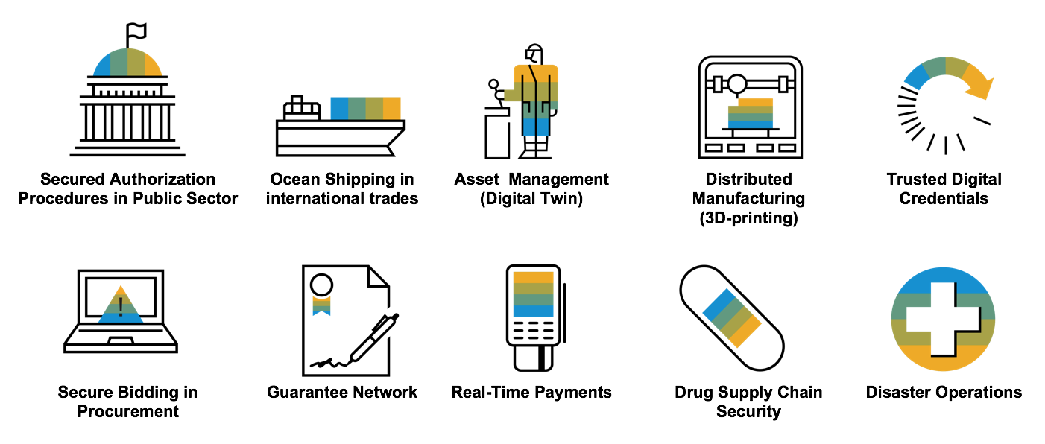
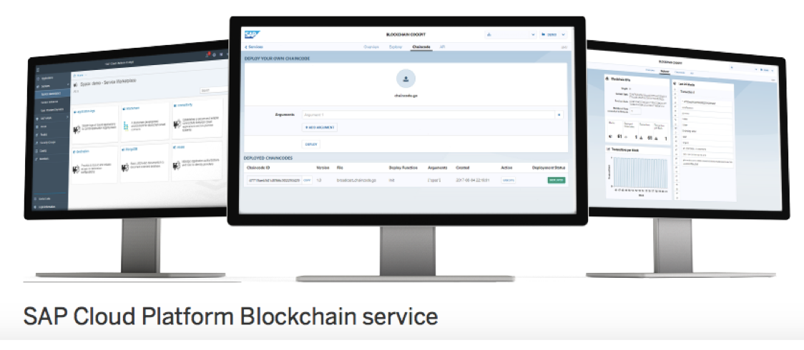















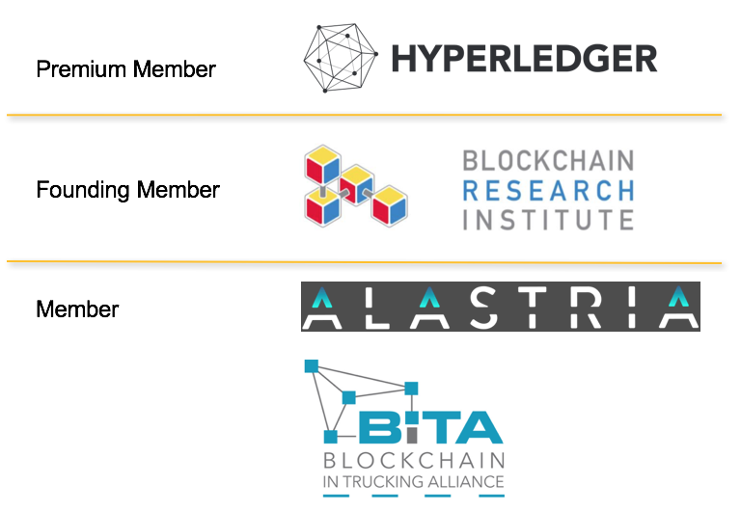




















Achievements in 2017
Philip Morris International

Slide 20

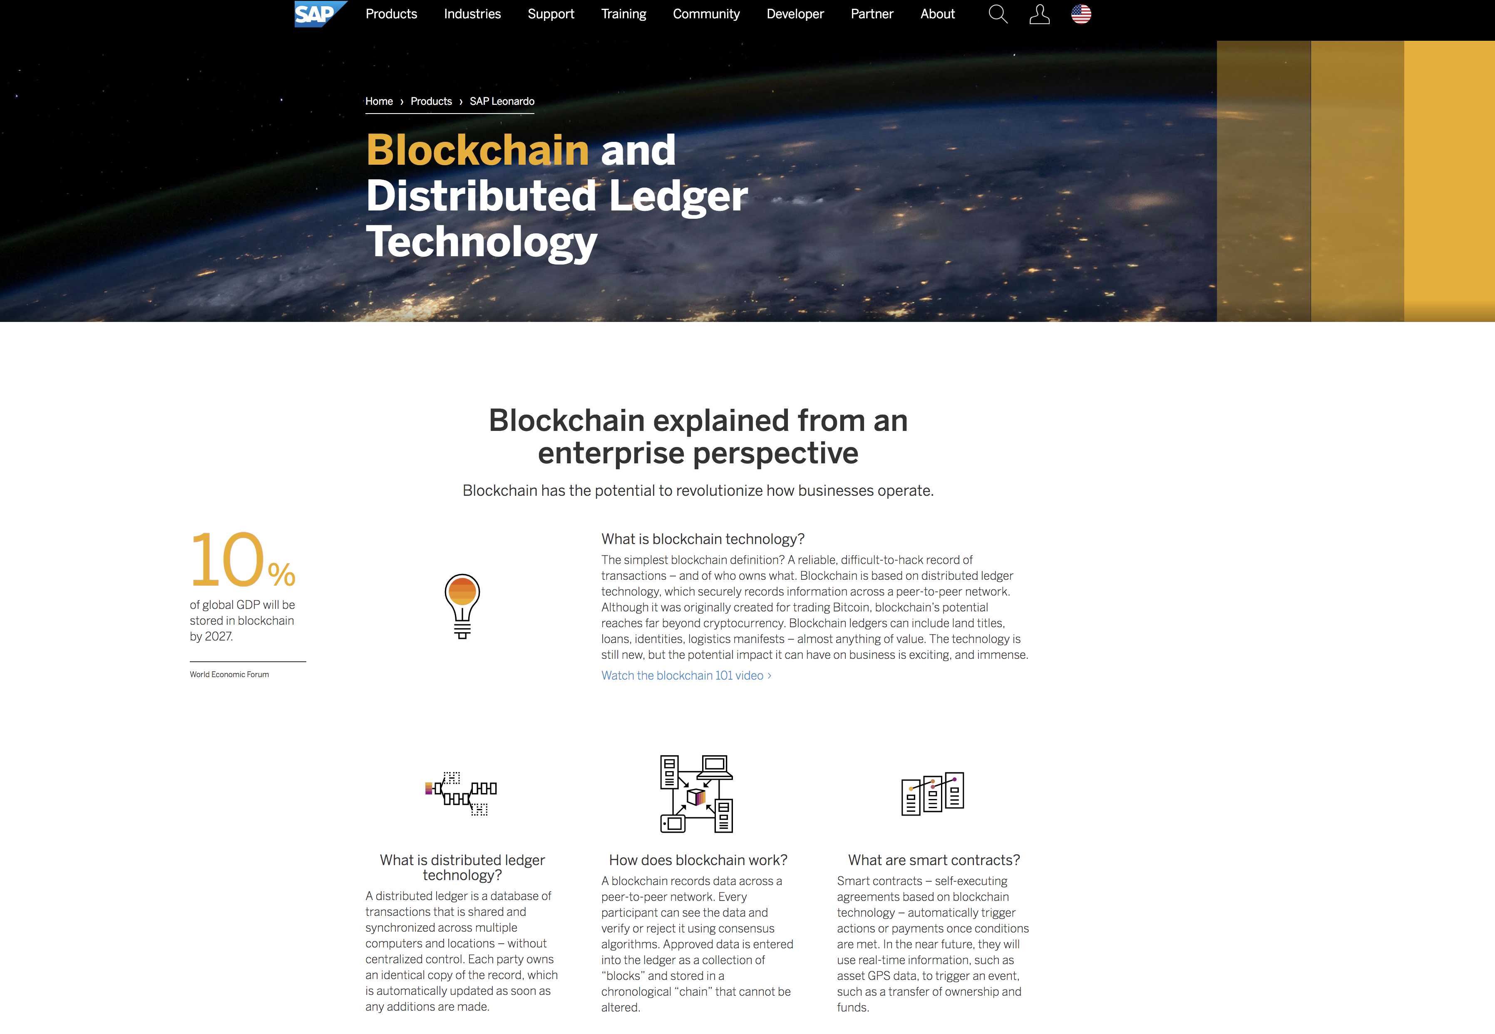
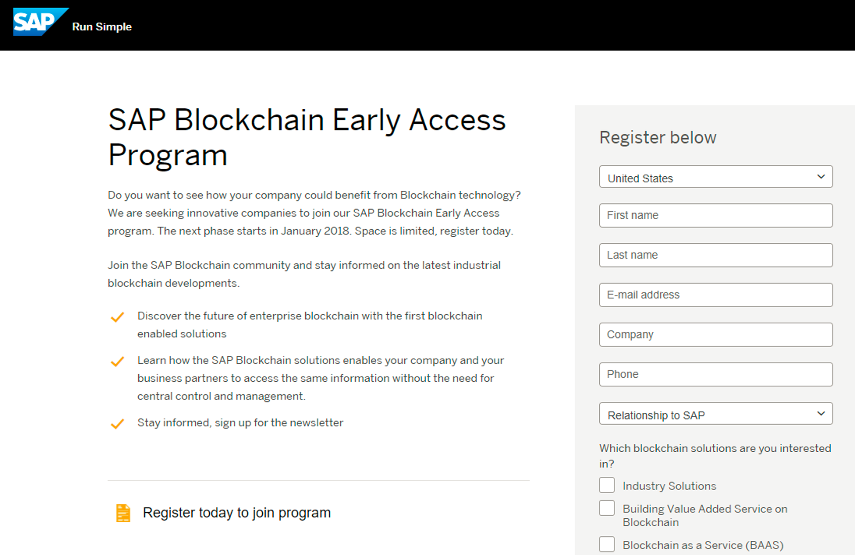
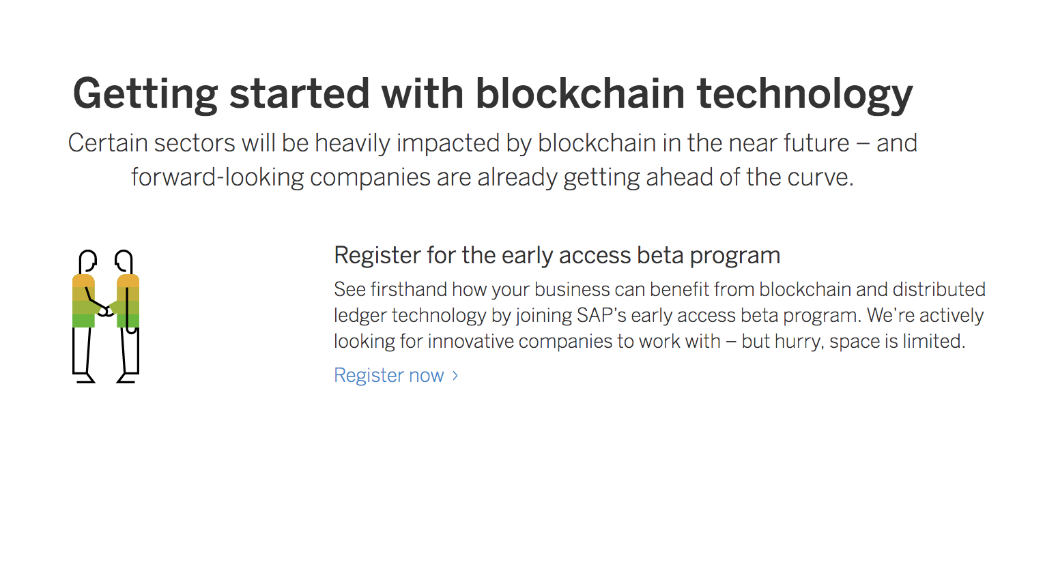
SAP Blockchain Early Access Program
www.sap.com/blockchain
Notes:
Get started with our example application to examine the potential of blockchain technology. Share your feedback with us and help us to define value added services for scenarios like asset transfer, document proof or track & trace that natively should be supported by the SAP Cloud Platform.

Slide 21
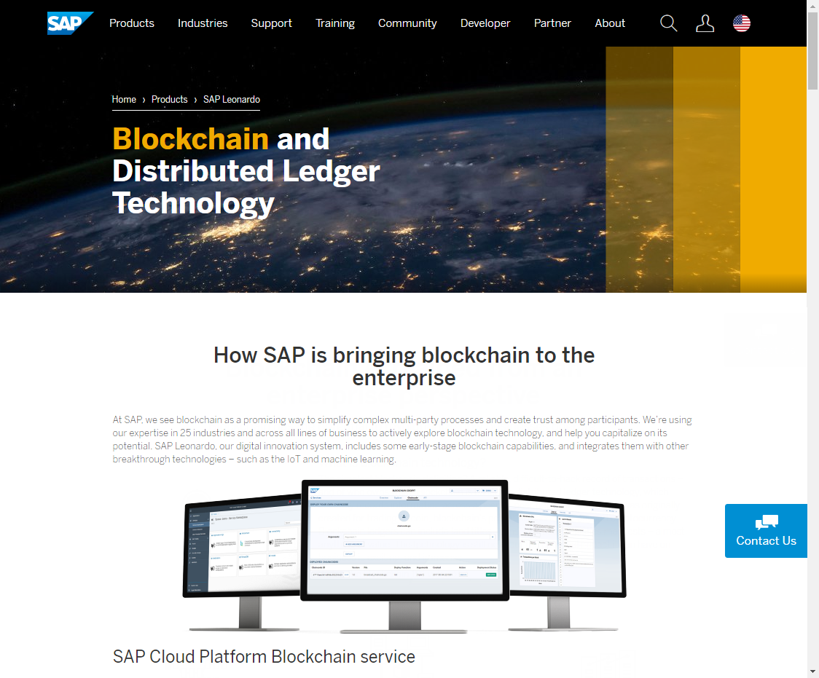
Get in Touch!
Website | sap.com\blockchain
Assets | SAP Leonardo Blockchain
Regional Contacts | https://go.sap.corp/BlockchainContacts
Online Courses | Blockchain getting started Blockchain Learning Framework
Social Media | @SAPLeonardo on Twitter
Co-innovate | → Early Access Program

Slide 22
APPENDIX

Slide 23
Key Messages
Bitcoin ≠ Blockchain
Blockchain = concept for decentral ledger networks
SAP Cloud Platform Blockchain Service
Integral part of SAP Leonardo technology portfolio
Enables SAP applications to use blockchain capabilities
Multi-node, multi-cloud, multi-platform
Business value is always created on application level

Slide 24
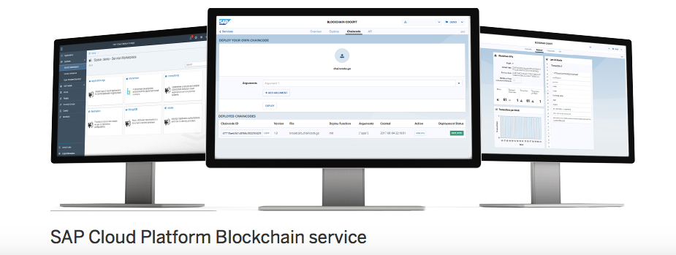
How SAP is bringing blockchain to the enterprise

Slide 25
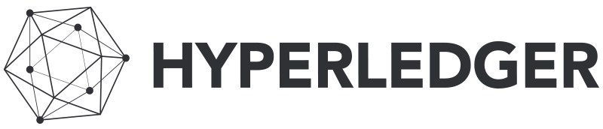
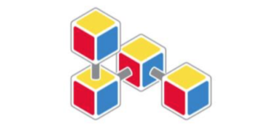
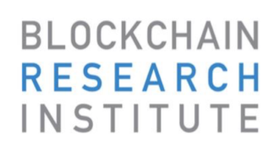


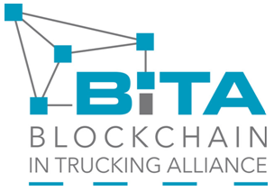
SAP and the Blockchain Eco-System
Premium Member
Founding Member
Member
Notes:
SAP is a PREMIUM member of Hyperledger, we see Hyperledger as the most promising open source consortium at the moment.
However, SAP today is engaged in various groups and open source initiatives,
We also joined the Blockchain Reasearch Institue as a founding member.
Participation in Alastria, which brings together banks, telecom providers, energy companies, universities, smart-city organizations and developers, will allow SAP to strengthen its blockchain ecosystem and network in Europe.
As a member of BiTA, an organization promoting the development of blockchain standards and education, SAP will expand its reach in freight and transportation management.

Slide 26
What is Blockchain?
Composition of Existing Technologies
Decentralized peer-to-peer technology
Private / Public key cryptography + hashing algorithms
Consensus algorithm
Database
Distributed
Transparent
Immutable
Cryptographically Linked Blocks

Slide 27
Overview: Blockchain Consensus Algorithms
A consensus algorithm as part of a blockchain is used to guarantee a consistent state of the shared ledger/journal of transactions.
In public blockchains such as Bitcoin it leverages cryptographic functions requiring high computational power to guarantee consistent block creation in a network with anonymous participants.
In private/consortium blockchains a consensus algorithm is used to solve the concurrency write problem only.
Blockchain Platform:
Bitcoin/Ethereum
Multichain
Hyperledger
…
Proof-of-Work:
For each block a crypto-graphical puzzle must be solved that requires massive computer power.
Assuming 51% good nodes the blockchain history can not be changed.
Round-Robin Block Creation:
One validator per block, working in a round-robin type of fashion. All validators are known and have permissions to create blocks.
In private blockchain sufficient as participants are well known.
Practical Byzantine Fault Tolerance (PBFT):
It is a consensus algorithm that tolerates the failures known of a minority of nodes.
The majority of nodes determines the valid blocks.

Slide 28
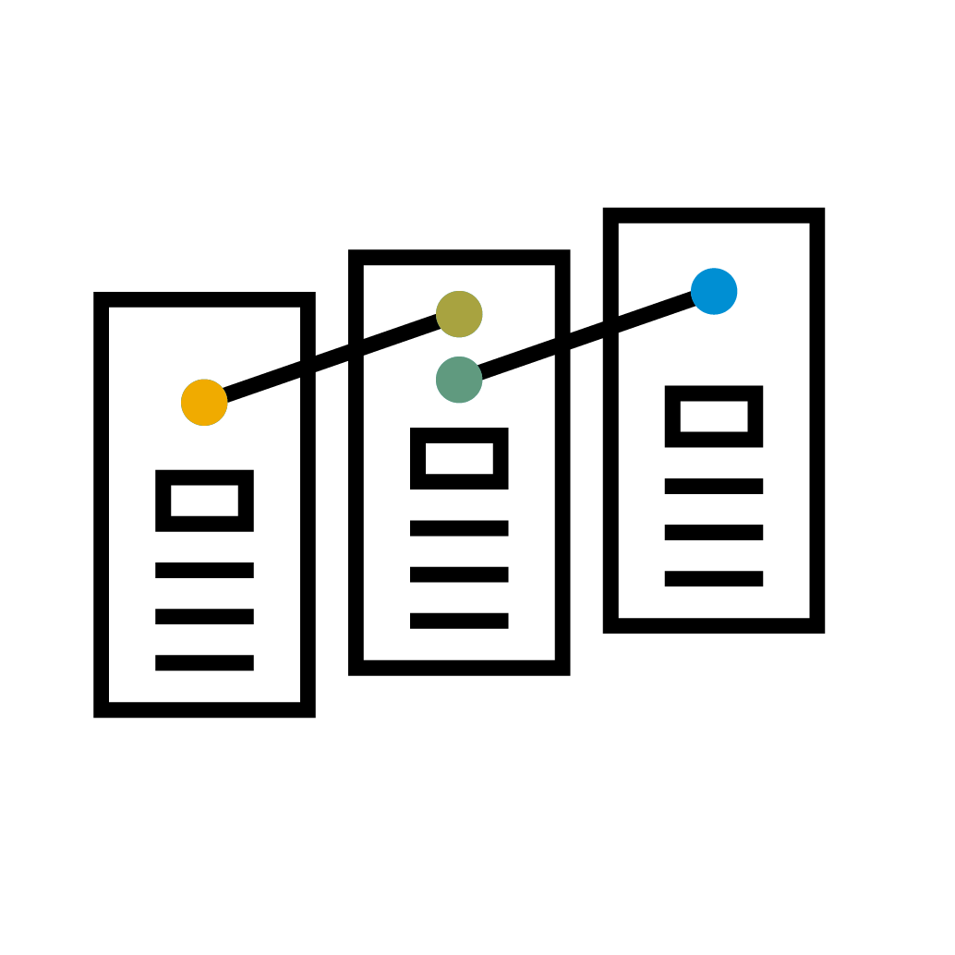
Overview: Smart Contracts in Blockchains
A smart contract is a piece of code embedded in the Blockchain and being executed by each validator.
It can represent a business contract and guarantees automation of business rule execution.
Smart contract is a new concept and creates challenges:
Code is Law philosophy is not the same as human interpretation of law
Decentral code execution requires a new development paradigm
Execution of Smart Contracts in VMs increases complexity of the blockchain platform
Security issues in Smart Contracts can result in much higher being published in public blockchains

Slide 29
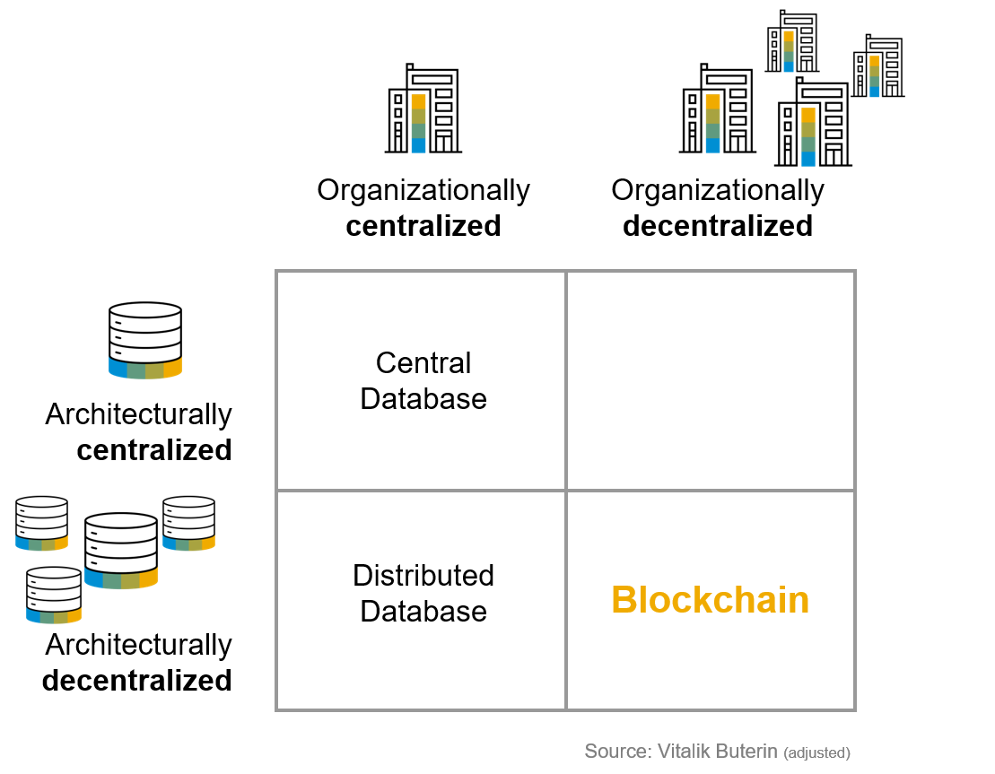
Blockchain and Databases – when to use what
Notes:
a

Slide 30
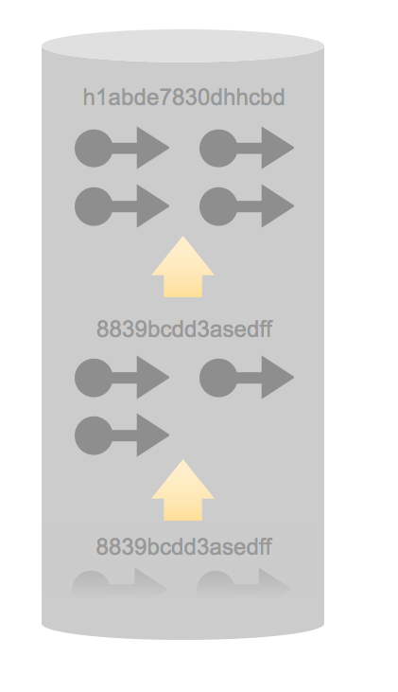
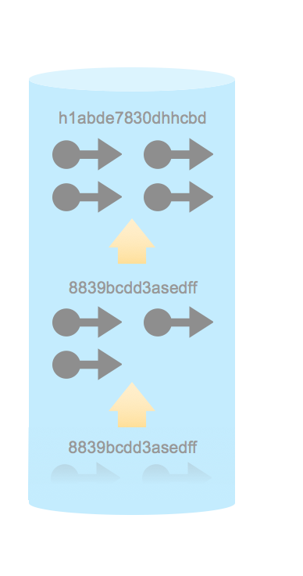
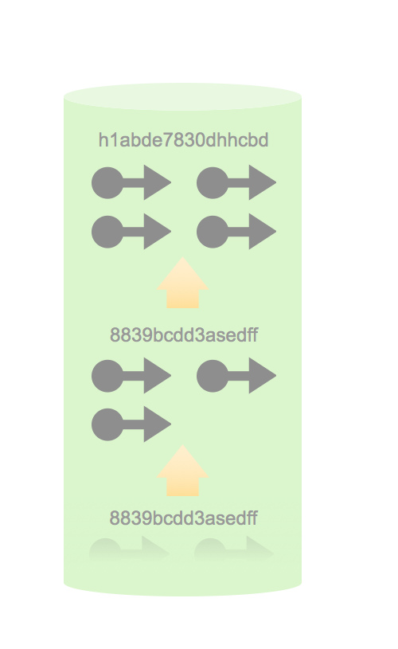
From databases to Blockchain
Technical view of the difference between a central database and a Blockchain
1
2
h1abde7830dhhcbd
Central Database
“Immutable“ Central Database
Transaction-based data only
Transaction will be digitally signed
Immutability of transactions:
8839bcdd3asedff
Hash a block of transactions
Generate a chain of blocks
➔ Chain of blocks
8839bcdd3asedff
3
4
“Immutable“ Distributed Database
“ Immutable“ Decentral Database
Distribute blocks using peer-to-peer technology
Generate consensus of data validity
Decentral organization of the network
Participants do not fully trust each other
Full transparency (among participants)
Automatic synchronization with consensus
No DB Admin
➔ Synchronized Distributed Database
➔ Blockchain
Notes:
Blockchain is not one new technology, but a composition of (existing) technologies:
Classic Database: Assume a classic database for a use case to record “simple” blockchain transactions (send, receiver, data)
Use cryptographical algorithms to hash a block of transactions. Create a chain of hashed blocks. => Once data is stored, data is immutable
Distribute blocks in a set of databases (Distributed database) and assume a consensus algorithm that automatically resolve concurrent write access to achieve consistent state across the databases (Distributed database with consensus) => Example of Consensus: Proof-of-work in Bitcoin
Move the trust border from an organization running a distributed database to individual nodes that do not fully trust each other => Blockchain

Slide 31
Characteristics of High-Potential Use Cases for Blockchain
Consider blockchain if (most of) the prerequisites are fulfilled:
Multi-party scenario (3 or more participants, preferably across companies/industries, e.g. consortia)
Participants on eye level (otherwise the dominant party might insist on a central server)
Shared repository (with joint data model/formats/semantics, standardization/harmonization are key)
Multiple writers (otherwise a master/slave replication could suffice)
Certain need for mutual control (for the blockchain network generates trust)
Intermediaries to be made obsolete (be careful not to get rid of middlemen that add huge value)
Need for transparency (to reduce risks, avoid fraud, be compliant to legal regulations, etc.)
Transfer of digitals assets (otherwise you need a unique link from real world objects to their digital representations)

